Slide 1
Beazley gpas and Billing OPERATING MODEL
Ways of Working Refresher for Product Owners
July 2024

Slide 2


Sprint Structure for Foundation Release
Focusing on execution of current sprint while doing elaboration for next sprint
A sprint is 4 weeks in duration
Each 4 weeks duration does execution of current sprint while doing elaboration for next sprint
Elaboration For Sprint 1
Development & Testing For Sprint 1
Last week has PREP meetings for SPRINT 2 ELABORATION
Elaboration For Sprint 2
Development For Sprint 2
Last week has PREP meetings for SPRINT 3 ELABORATION
Elaboration For Sprint 3
Last week has PREP meetings for SPRINT 4 ELABORATION

Slide 3
Sprint in action on a Timeline
Sp1 Elab completes
Sp2 - 4 weeks Elaboration begins
*Only Sp1 Elaboration is 3 weeks
Sp1 - 4 weeks Build begins
Week-3 |  |  |  |  | Week-1 |  |  |  |  | Week-2 |  |  |  |  | Week-3 |  |  |  |  | Week-4
Day-1 | Day-2 | Day-3 | Day-4 | Day-5 | Day-1 | Day-2 | Day-3 | Day-4 | Day-5 | Day-1 | Day-2 | Day-3 | Day-4 | Day-5 | Day-1 | Day-2 | Day-3 | Day-4 | Day-5 | Day-1 | Day-2 | Day-3 | Day-4 | Day-5
Sprint1 preparation, validate Sprint1 DoR
Sprint1 Planning
Start Sprint1 in JIRA
Test planning, review and signoff
Test design, execution and automation
Defect triaging and retesting
Regression, demo & Reporting
Incremental Feature Demos to be planned by Beazley Product Owner across sprints, not necessarily for each sprint.
Sp3 - 4 weeks Elaboration begins
Sp4 - Elaboration start
Sp2 - 4 weeks Build starts
Sp3 - Build starts
Week-1 |  |  |  |  | Week-2 |  |  |  |  | Week-3 |  |  |  |  | Week-4 |  |  |  |  | Week-1
Day-1 | Day-2 | Day-3 | Day-4 | Day-5 | Day-1 | Day-2 | Day-3 | Day-4 | Day-5 | Day-1 | Day-2 | Day-3 | Day-4 | Day-5 | Day-1 | Day-2 | Day-3 | Day-4 | Day-5 | Day-1 | Day-2 | Day-3 | Day-4 | Day-5
Validate Sprint1 DoD
Sprint2 planning
Start Sprint 2 in Jira
Optimisation levers:
User story pushed to dev pipeline when ready
Show and tell as soon as the user story is ready
Early visibility into sprint closure through Jira dashboards
Jira to be used as the Single source of Truth on story development progress
Testing dashboards for real time progress on test- execution and defect trends
Validate Sprint2 DoD
Sprint3 Sprint planning
Start Sprint3 in Jira
Sprint2 Retrospective
Sprint1 Closure report
Sprint1 Retrospective
Sprint2
Closure report

Slide 4
Expectations for Elaboration Workshops
Cap team
Beazley PO / SMEs
Cap team
Beazley PO / SMEs
  Agree on Sprint Scope with PO/SMEs
  Refresh your knowledge on current State Business Processes and pain points
  Identify User Stories and Backlog requirements for the Sprint
  Talk through detailed requirements specific to every Backlog item
  Schedule Elaboration sessions & send meeting invites ahead of time
  Schedule Elaboration sessions & send meeting invites ahead of time
  Speak up. Question if something is unclear
  Walkthrough & discuss in detail the Backlog Requirements
  Challenge your current Process if proven ineffective
  Demonstrate OOTB capabilities.
  Whiteboarding, Case studies, talk through proven capabilities, where necessary
  Openness to Business Process change needed
  Gather & document detailed Functional requirements including Business Rules, Permission, Activities, Audit trail etc.
  Adapt vs Adopt
  Capture Key Decisions, Actions & track them
  Exceptions always exist. Find ways to work-around them
  Document Acceptance Criteria for the User Stories
  Stay close to OOTB Solution
  Conduct Playback sessions & Share User Stories for Sign-off
  Focus on ‘What’ and not ‘How’

Slide 5

‘A day in a life’ during Elaboration Workshops
Actors
Product Owner
SMEs
Solution Architect
Team members
Functional lead / BA
Elaboration
Accelerators / Tools
Elaboration
readiness
Output
Mile-deep; Inch wide
Advanced Product Designer
Mind map
Feature matrix
Business rules, FLS & other templates
Decision Log, Action Item tracker, Query log
Guidewire Accelerators (e.g. Co-insurance)
Updated Sprint Plan
Elaboration session Guardrails
Right Tools – Signed-off Release Backlog from Inception, Functional accelerators
Preparedness to Workshop topics
Guidewire OOTB Cloud Instance for demo
Process during Implementation phase, Program Management Tools etc.
As-is Business Process flows
HL Future State Business Process flows from Inception
Playback sessions* to demonstrate Requirements captured
Signed-off User Stories including Business Rules, FLS and Acceptance criteria
Integration Inventory
Key Decisions, Pending Actions, Parked items Log
Updated Future State process flows
Low level Designs
Architectural Decision log
Updated Dependencies Tracker
Updated RAID log
User Stories handed over to Dev & Test teams
Best Practices
Maximize Product Value
Demonstrate OOTB capabilities
Use wireframes or mock-ups
Leverage Workshop tools
Storyboarding
Build incrementally
Think holistically (‘Big Picture’)
Bring on board all relevant Workstreams to the sessions
80:20 rule
One Team approach
Seamless communication
Follow Agile Ceremonies
Elaboration
readiness
Elaboration Workshops
Understand Guidewire Product Capabilities
Deep-dive into Ways of working, Program methodology for Implementation phase
Understand Release Scope
Understanding base Architecture (e.g. Headless architecture for PolicyCenter)
Understanding UWWB Scope, capabilities and what has been built & planned
Enabling SMEs with authority to decide
Adapt Vs Adopt
1. Strategize
3. Synthesize
2. Conduct
Tasks / Ownership
Tasks / Ownership
Tasks / Ownership
Tasks / Ownership
Challenges
Architectural design and decisions
Low level Designs
Integration approach
Migration Strategy
Data mart or Data lake designs
Third Party Dependencies
Other Tooling required
Facilitate & Deep-dive into Business Requirements
Understand detailed business process
Demonstrate OOTB functionality
Identify areas of system change
Identify dependencies & impacted systems
Capture requirements;, Key decision, Actions & Parking lot items
Own and close assigned actions in time
Capture workshop notes, detailed requirements & failover conditions
Scope change on signed-off requirements
Thinking inside of Legacy box
Trying to create Perfect Solution
Over customization
Procrastination & indecisive
Moderate workshops
Bring in Right participants
Make decisions quikcly
Encourage SMEs to make decisions
Identify action Owners & resolve dependencies
Own &/or Assign actions
Drive actions to closure
Ensure workshop alignment with ‘Big Picture’
Preparedness to Workshop
Active Participation
Provide detailed Business Requirements
Elaborate Current State Process / rationale
Make decisions quickly
Own actions end to end
Close actions in time
80:20 rule
Adapt vs Adopt

Slide 6
‘A day in a life’ during Elaboration Playback sessions*
Accelerators / Tools
Requirements gathered
Mockups
Data model changes
Business rules, FLS & other templates
Actions & resolutions
Functional lead / BA to replay all the User Story requirements gathered from the Workshops
Capture/ incorporate feedback on the played-back requirements
Walkthrough Screen mockup & data model changes, Business rules, Activities and Audit trail forming part of the User Story
User Story or Requirements document updated based on SME/PO feedback to existing requirements
Best Practices
Capture any pending actions, parked items & impacts therefor to the current User Story/Sprint
Any new or changes to existing requirements gathered to be taken-away for assessment & plan of action
Bring all the required Stakeholders into the room
Ring fence Playback Scope to relevant User Stories & requirements
Lead-support roleplay
Avoid any new requirements or changes to current requirements captured
Capture & incorporate feedback online to the Pack
Capture any new risks, dependencies or issues raised to action offline
Repeat the exercise for all the Requirements/User Stories
Capture and circulate the minutes from Playback-session
SMEs and Product Owner to validate and agree on every US requirements presented
The User Stories accepted during the play-back will be shared with PO for sign-off
Challenges
Actors
Product Owner
SMEs
Solution Architect
Team members
Functional Lead / BAs
Test teams
Not having the right participants in the room delays the process
Missing the big picture
Trying to create Perfect Solution
Procrastination & indecisive

Slide 7
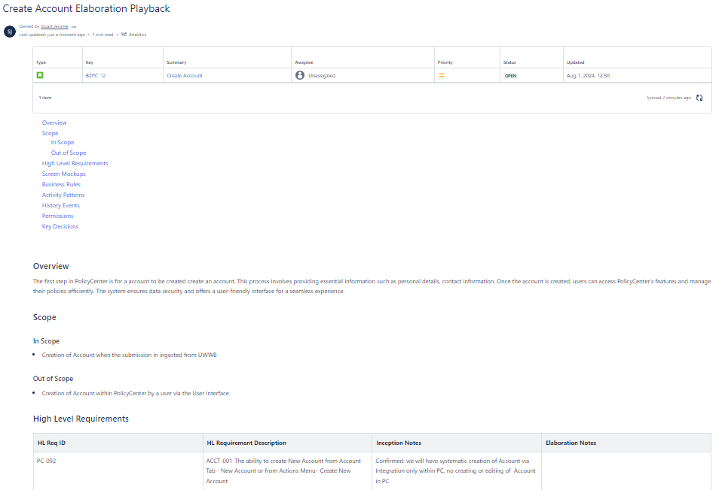
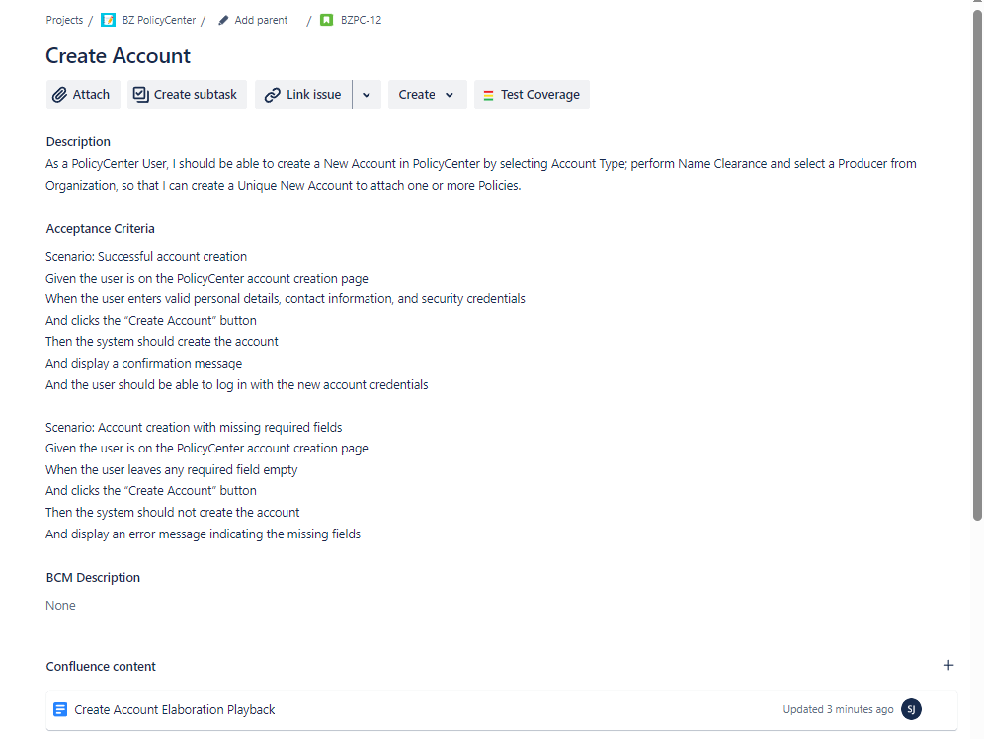
Requirements Documentation
Capturing Requirements
The primary location for the documentation of all requirements will be confluence
Where confluence does not offer appropriate capability to capture certain requirements then an excel document may be used which would then be embedded into the confluence pages. (Use of Confluence tables currently being assessed)
All Acceptance will reside against the user story ticket within JIRA with all requirement artifacts linked from Confluence

Slide 8
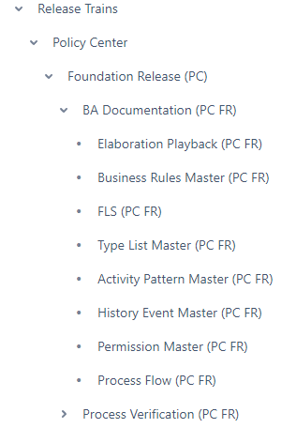
Requirements Documentation
Requirement Artifacts
Elaboration Playback – Used as the main container for requirements throughout elaboration up to PO sign off. Once approved the Playback will be locked down and all requirements transferred to the master requirement artefacts (screen
Field Level Specification – This will house all field level attributes including conditional rules, visibility rules etc.
Business Rules Master – This will house all system related business rules that need to be configures in PolicyCenter
Typelist Master – This will house all of the type list values within PolicyCenter which will then be reference in the FLS against the applicable attributes
Activity Pattern Master – This will house all the activity patterns that are required in PolicyCenter including details such as due date, escalation date etc. Trigger rules for the activities will be detailed in the Business Rules master and mapped to the relevant activity
History Events Master – This will house all the History event required
Permissions Master – This will house all the user permissions
Process Flows – Will be used to document system and process flows to support requirements
JIRA User Story – The JIRA ticket will house the Acceptance Criteria and all the links to the above artifacts

Slide 9
BillingCenter Sprint 1 & 2 Plan
Sprint 1
Plans - Billing Plan
Payment plan
Payment Allocation plan
Charge patterns
Commission Plan
Return Plan
Agency Bill Plan
Other activities
Broker Organization setup (initial elaboration)
Invoicing design
Sprint 2
Retrieve Billing Instructions
Setup Billing Account
Policy and Producers
Charges – Premium
Taxes
Submission Invoicing
Payment schedule
Other activities
Invoicing design (contd.)
Elaboration – Week 1
Elaboration – Week 2
Playback
06-Aug
08-Aug
13-Aug
14-Aug
19-Aug
21-Aug
Account Creation & Update – Session 1
Account Creation & Update – Session 2
New Submission – Ingestion on Clearance – Session 1
New Submission – Ingestion on Clearance – Session 2
Account Creation & Update - Playback
New Submission – Ingestion on Clearance - Playback

Slide 10
PolicyCenter Sprint 1 & 2 Plan
Sprint 1
US D&O Product Model Setup
INT- Expose Product Model Definition service
Create Account via Integration
Update Account via Integration
View and Manage Account Summary
Create New Submission – Point of Clearance/Assignment
Sprint 2
Create New Submission – Point of Quote
Update New Submission - Ingest Additional Quote Versions (UWWB)
Forms inference / Document triggers (No integration)
Subjectivities (Wording library - Integration dependent)
Close options
Auto NTU/Lapse
Elaboration – Week 1
Elaboration – Week 2
Playback
06-Aug
08-Aug
13-Aug
15-Aug
19-Aug
20-Aug
Account Creation & Update – Session 1
Account Creation & Update – Session 2
New Submission – Ingestion on Clearance – Session 1
New Submission – Ingestion on Clearance – Session 2
Account Creation & Update - Playback
New Submission – Ingestion on Clearance - Playback

Slide 11
Sprint Events and RACI
Tasks | Accountable | Accountable Team | Supporting Team | SLA/Expectations
Backlog requirements elaboration | Beazley | Beazley PO, Beazley B SME | Capgemini BA
Requirements conformance to GW product specs | Beazley | Beazley PO, Beazley B SME | Capgemini BA, Capgemini Technical team | Capgemini BA to escalate to the PO/Business SME if requirement are deviating from product conformance (ex <90%). This happens immediately during the Sprint elaboration sessions much before development begins
Requirements clarification for dependent systems | Beazley | Beazley PO, Beazley B SME | Capgemini BA, Capgemini Technical team | All dependent RT expectations are aligned by the Beazley PO
Business validation definitions | Beazley | Beazley PO, Beazley B SME | Capgemini BA
Acceptance criteria definition | Beazley | Beazley PO, Beazley B SME | Capgemini BA
Business Process Maps traceability to GPAS & Billing Backlog Items | Beazley | Beazley PO, Beazley SME | Capgemini BA | L4 Process Maps created by Beazley to be mapped to GPAS & Billing backlog items at Epic/Feature level by Beazley
User story creation | Capgemini | Capgemini BA | Beazley PO, Beazley B SME
User story creation in JIRA | Capgemini | Capgemini BA | Capgemini RTL, Technical SME, Capgemini BA
User story sign-off | Beazley | Beazley PO, Beazley B SME | Capgemini BA | All user stories to be signed off by PO within 2 days after issuance
Sprint planning | Capgemini | Capgemini Release Train lead | Beazley PO, Beazley B SME(s) | All Beazley managed Release Train leads, Beazley PO, Beazley Business SME
Playback sessions | Capgemini | Capgemini BA | Beazley PO, Beazley B SME | All Beazley managed Release Train leads, Beazley PO, Beazley Business SME
Backlog adjustments | Capgemini and Beazley | Capgemini PO, RTL Beazley PO | Capgemini Technical team

Slide 12
Sprint Events and RACI
Tasks | Accountable | Accountable Team | Supporting Team | SLA/Expectations
Validate Sprint Definition of Ready | Capgemini | Capgemini RTL, Capgemini BA | Beazley PO, Beazley B SME
Validate Sprint Definition of Done and Sprint acceptance | Beazley | Beazley PO, Beazley Programme Manager | Capgemini RTL, Capgemini Technical SME | Beazley Programme team to sign off Sprint Closure report issued by Capgemini within 24 hours after submission A summary of the Sprint DoD status supported by JIRA reports (specifics to be agreed) Time to issue report : Up to One week after Sprint completion
Validate User story definition of ready | Capgemini | Capgemini RTL, Capgemini BA | Beazley PO, Beazley B SME
Validate User story definition of done | Capgemini | Capgemini RTL, Capgemini BA | Beazley PO, Beazley B SME
User story show and tell (Demo) | Capgemini | Capgemini RTL, Capgemini BA | Beazley PO, Beazley B SME | Beazley to sign off the stories in JIRA within 24 hours
Incremental Feature Demo | Beazley | Business Product Owners, Business SME | Capgemini BA | Beazley to decide on the timing for an incremental feature demo
JIRA reports for all DoD, DoR | Capgemini | Capgemini JIRA admin
Sprint start and closure in JIRA | Capgemini | Capgemini RTL, Capgemini RTL, Capgemini JIRA admin | Beazley PO, Beazley B SME, Beazley Programme team | Beazley Programme team to sign off the JIRA report for Sprint start and closure
Technical tasks creation in JIRA | Capgemini | Capgemini Technical leads, RTL
Updates to JIRA user story progression (dev, test etc) | Capgemini | Capgemini RTL, Capgemini Technical Leads
Sprint retrospective | Capgemini | Capgemini RTL | Beazley PO, Beazley B SME

Slide 13
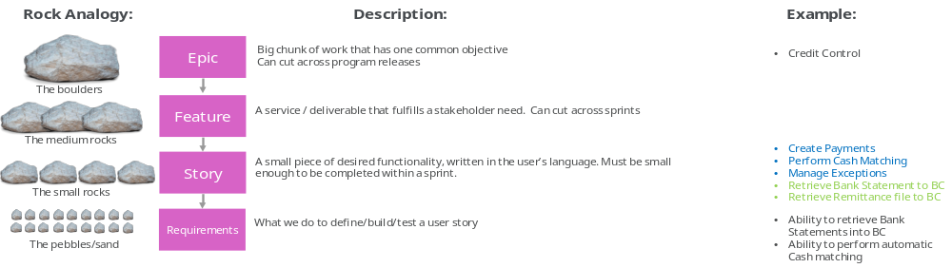
Jira Setup - Overview
Project Name: Beazley GPAS & Billing Program
Story 1
Sprint 1
Initiative
Story 2
Sprint 2
Story 1
Story 3
Epic -1
Story 2
Story 4
Sprint N
Story 3
Story 5
Story 4
Billing Project
Story 10
Story 5
Story 5
Sprint 1
Epic -2
Story 6
Story 6
Story 7
Sprint 2
Story 3
Story 8
Story 7
Sprint N
Story 12
Story 9
Story 8
Epic -3
Story 10
Integration Project
Story 11
Story 9
Sprint 1
Story 7
Story 12
Story 10
Sprint 2
Story 9
Story 11
Sprint N
Story 12

Slide 14
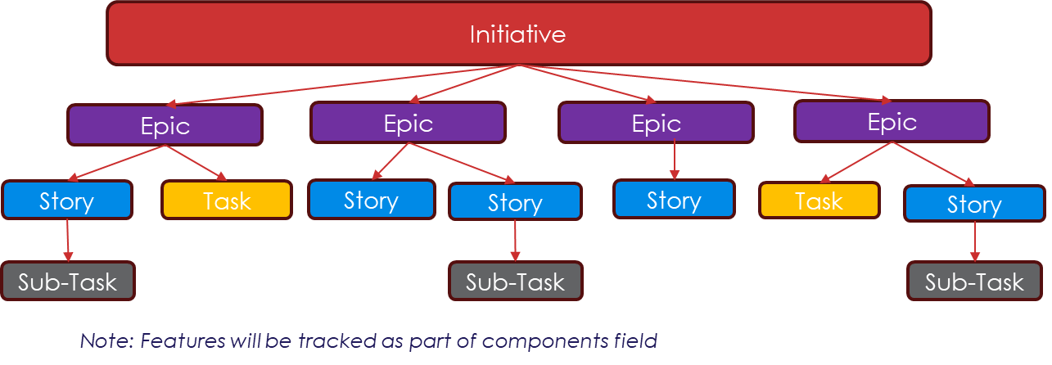



Jira Structure of a project
Project
(Workstream)
BZ PolicyCenter
Scrum board 1
BZFoundation R1
Scrum board 2
BZPolicyCenter R2
Scrum board 3
BZPolicyCenter R3
Project
(Workstream)
BZ Billing
Scrum board 1
BZFoundation R1
Scrum board 2
BZBilling R2
Scrum board 3
BZ Billing R3
Scrum Board
Release Backlog
Sprint Backlog
Sprint board (Active Sprint)
Reports

Slide 15
Jira User Story workflow
Product Backlog
All
To Do
Deferred
All
All
Blocked
In Refinement
Archived
All
Refinement Complete
Ready for Design
Ready for Development
In Code Review
In Development
Development Blocked
Ready for Test
In Testing
Testing Blocked
Ready for Showcase
Done
Service Ticket ID: RITM1137241

Slide 16
governance
The overall success of this engagement will be based on close collaboration between all parties, transparency and fact-based decision making. We will also use this Governance process to keep us all collectively honest and true to the Programme objectives.
Note: Under Review
Monthly
SteerCo
Supplier Review
Reporting
Programme Working Group
Decisions
GPAS Programme Management Update
Weekly
Technical Design Authority
Business Design Authority
Change Control Board
Dependency Review Forum
RAID Review
Daily
Agile – Daily Stand-up / Scrum of Scrums

Slide 17


PROPOSED Roles & Ceremonies MatriX
Roles & Ceremonies | Daily Standup (Release train) | Daily Scrum of Scrums (RT Leads) | Cap/BZ Joint Stand-up | Dependency Forum | PMO RAID Review | Supplier Review Meeting | Program Management update | Change Board | Business Design Authority | Technical Design Authority | Program Working Group | Steer Co
Business Sponsors /Delivery Exec |  |  |  |  |  |  |  |  | x |  |  | x
Programme Director |  | x | x | x | x | x | x | x | x |  | x | x
Delivery Leads |  | x | x | x | x | x | x | x | x | x | x | x
Product Owner | x | x |  | x | x | x | x | x | x |  |  | x
Functional Leads | x | x | x | x | x |  | x | x | x |  | X
Subject Matter Experts |  | x |  |  |  |  | x | x | x | x
Architects | x | x |  | x | x |  | x |  | x | x | x
Platform Owners |  | x |  | x | x | x | x | x | x | x |  | x
Technical Leads | x | x | x | x | x |  | x | x |  | x
Test Managers | x | x | x | x | x |  | x | x
Development Team | x |  |  |  |  |  | x
Product Rationalization Team | x | x |  | x | x |  | x |  | x | x |  | x
Procurement Team |  | x |  | x | x | x | x
DevOps Team | x | x |  | x | x |  | x |  |  | x
PMO Team |  | x |  |  | x | x | x |  |  |  | x

Slide 18
Proposed Programme CADENCE
All Daily stand-ups are ownership of respective Release Train leaders
All Leadership update Stand-ups (like SOS, Change Board, BDA, TDA etc) are ownership of Beazley to organise, conduct & track. Capgemini to be part of them & provide inputs as per process
Key
Daily | Weekly | Fortnightly | Monthly | Quarterly
*Supplier Review Meeting occurs following Friday of sprint closure
IST
BST
US CTZ
US ETZ
Monday
Tuesday
Wednesday
Thursday
Friday
14:30 - 15:00 | 9.00 – 9.30 | 03:00 – 03:30 | 04:00 – 04:30
15:30 – 16:15 | 10.00 – 10.45 | 04:00 – 04:45 | 05:00 – 05:45
16:30 – 17:30 | 11.00 – 12.00 | 05:00 – 06:00 | 06:00 – 07:00
17:30 – 18:30 | 12.00 – 13.00 | 06:00 – 07:00 | 07:00 – 08:00
18:30 – 19:30 | 13.00 – 14.00 | 07:00 – 08:00 | 08:00 – 09:00
20:00 – 20:30 | 14.30 – 15.00 | 08:30 – 09:00 | 09:30 – 10:00
20:30 – 21:30 | 15.00 – 16.00 | 09:00 – 10:00 | 10:00 – 11:00
21:30 – 22:30 | 16.00 – 17.00 | 10:00 – 11:00 | 11:00 – 12:00
Daily Standups
Daily Standups
Daily Standups
Daily Standups
Daily Standups
Daily stand ups are within respective Release Train Teams. This includes both Technical & Functional teams from Capgemini in UK & India.
Functional Catch up with Product Owner is planned twice a week
Scrum of Scrums
Scrum of Scrums
Scrum of Scrums
Scrum of Scrums
Scrum of Scrums
To allow Product Owners to join SoS, it is aligned to US morning.
Capgemini will be represented by Release Train Leads & Functional leads from UK
Release Train Leads and the POs have an opportunity to catch-up on the SoS
Unless required, no India representation available

Slide 19
Proposed Programme CADENCE
All Daily stand-ups are ownership of respective Release Train leaders
All Leadership update Stand-ups (like SOS, Change Board, BDA, TDA etc) are ownership of Beazley to organise, conduct & track. Capgemini to be part of them & provide inputs as per process
Key
Daily | Weekly | Fortnightly | Monthly | Quarterly
*Supplier Review Meeting occurs following Friday of sprint closure
IST
BST
US CTZ
US ETZ
Monday
Tuesday
Wednesday
Thursday
Friday
14:00- 14:30 | 8.30 – 09.00 | 02:30 – 03:00 | 03:30 – 04:00
14:30 - 15:00 | 9.00 – 9.30 | 03:00 – 03:30 | 04:00 – 04:30
15:30 – 16:15 | 10.00 – 10.45 | 04:00 – 04:45 | 05:00 – 05:45
17:30 – 18:30 | 12.00 – 13.00 | 06:00 – 07:00 | 07:00 – 08:00
18:30 – 19:30 | 13.00 – 14.00 | 07:00 – 08:00 | 08:00 – 09:00
19:30 – 20:30 | 14.00 – 15.00 | 08:00 – 09:00 | 09:00 – 10:00
20:30 – 21:30 | 15.00 – 16.00 | 09:00 – 10:00 | 10:00 – 11:00
21:30 – 22:30 | 16.00 – 17.00 | 10:00 – 11:00 | 11:00 – 12:00
Cap/BZ Joint Stand-up
Cap/BZ Joint Stand-up
Cap/BZ Joint Stand-up
Cap/BZ Joint Stand-up
Cap/BZ Joint Stand-up
First hr catch-up with Capgemini RTEs to review SoS actions as necessary
RTE, Beazley and Capgemini Program Managers
Program Management Update
Program Working Group
Supplier Review*
Dependency Forum & PMO RAID Review
Change Board
Technical Design Authority
Business Design Authority
Steer Co
The TDA and BDA forums are suggested to be GPAS & Billing Program specific to low level design decisions
Those impacting systems outside of GPAS & Billing must be taken up at the wider Modernization authorities (existing forums)

Slide 20

Escalation process
Executive Level:
Escalation Etiquette:
Other key stakeholders:
Business Sponsor
Delivery Executive
Account Executive
Escalations
Decisions / Actions
Escalations are done jointly from Capgemini and Beazley representatives from one level to Capgemini & Beazley representatives at the next level up.
Prior to escalation, representatives will work together to:
Agree what they agree on
Agree what they disagree on
Prepare for the escalation, making clear:
  The problem statement
  The options for resolution and their pros and cons
  The decision(s) and / or action(s) required
  The date required by
  The impact of doing nothing / missing the date
Finance modernisation
Underwriting & Servicing
Data Migration
Operations
Programme Director
Programme Director
Delivery Lead
Delivery Lead
Product Owner
Functional Lead
Project Team:
Business SMEs, Business Analysts, Architects, Engineers, UAT team etc.
Business Analysts, Architects, Designers, Engineers, QA / Testers, DevOps, Scrum Masters, Data Scientists

Slide 21
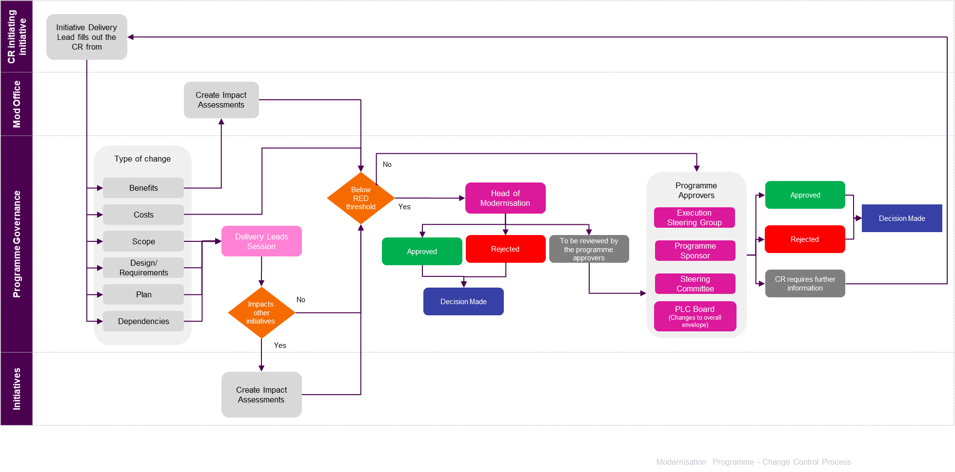
Change control
Controlling change via an agreed process that acknowledges it is needed but manages its impact for the good of delivery is key to the success of this largescale programme delivery.

Slide 22
User story – DoR and DoD
User Story Definition of Ready
User Story Definition of Done
Requirement package is signed-off by Beazley SME which consists of a documented user story and acceptance criteria(s)
User Stories are elaborated to have detailed functional, non-functional, integration requirements, business rules, FLS, process flows, mockup screens (only if applicable) and well-defined acceptance criteria
Requirements hand-over is complete by Cap BA to development team
All known dependencies associated with delivering a story have been resolved or any pending ones have an eta for resolution not affecting the user story development outcome
Any dependent user story across PC config, integration, policy or billing is already available or has a plan in place not impacting the current story acceptance criteria
Product dependencies (finalized Xmind map and APD ) for story development are available
User story development does not add customization above permissible guideline of 10%
Any pre-dev tasks created during elaboration are marked complete in JIRA
Third party connectivity dependency is resolved and available
Agreement in place to use stub services or an alternate in absence of a working live integration
User story is successfully demonstrated on top of the code built during the Sprint, that meets the acceptance criteria and is signed off by the PO/Business SME
Unit test result and code review result are uploaded in Jira/Confluence
Stub routines used to complete unit testing where a third-party service live integration is not available
Code complies with GW cloud coding and security standards; all valid observations have a plan of action agreed
Code is ready for deployment to a Test environment
All sub-tasks of the user story are in DONE status
Unit test cases to be achieved through Gunits
Data tracker should be updated for any Data model changes
Test execution is complete with no ‘ To Do’ test cases pending in Jira OR there is an agreement and ETA for the pending ones
No outstanding High Priority or Severity defects resolution open on the defects OR for any open ones, there is a conditional sign off with a ETA for fix. The defect priorities and severities will be assigned as per beazley QA defect management process. Ref testing - slide 65. The defects will be tracked in Jira through triage process.
Test data used to test the scenarios are relevant and sanitized to ensure no production data is used.
Identified automatable test cases are automation completed and integrated to the pipeline

Slide 23
Sprint – DoR and DoD
Sprint Definition of Ready
Sprint Definition of Done
Sprint backlog hand off (technical and functional clarifications with PO/Business SME) is complete and user stories are in compliance with Definition of Ready
Sprint backlog is based on the available sprint capacity (Build & QA hours available)
Product Data Model requirements are finalized any Data requirements are resolved or have a plan in place without impacting Sprint delivery
HLA is signed-off by the architecture team wherever applicable ( applicability of this is determined during elaboration of requirements)
Other Design items to be in place
  External API or vendor specification document
  IP whitelisting completed for any third-party connectivity
  Service request and response mapping documents
All dependencies have been resolved. Dependency items are agreed for all third-parties (internal and external)
Environment configuration completed, and access setup done for Release train members
All user stories and sub tasks within a user story are in Done status
Completed user stories follow the User Story Definition of Done or any exception is agreed with Beazley
Stories not in ‘Done’ status have been moved out of the sprint in agreement with Beazley – Stories not in Done status are discussed with respective Product Owner based giving a visibility of a completion plan or a risk if exists. Story is either moved to subsequent sprint or parked in backlog for further action. (Please refer to User story management section for specific scenario covering this)
Test execution is complete in Jira with no test cases in ‘To Do’ status or if any exception is agreed with Beazley
High priority or severity defects have been either closed or there is a mutually agreed fix plan with Beazley for the open defects
Code has been checked-in accordance with the DevOps pipeline
Sprint completion reports has been shared with Beazley stakeholders - Product Owner, Programme management team
Automation testing (if applicable) has a coverage to the requirement level as defined in the test strategy
Sprint completion reports have been shared with Beazley stakeholders - Product Owner, Programme management team
PO – Product Owner
HLA – High Level Architecture

Slide 24
Tracking Sprint progress
Each Sprint to have a daily reporting through JIRA dashboards to track velocity numbers by story or story points and other test metrics as applicable. The dashboard designs will be agreed between the RTLs and programme governance teams. Following are some of the standard metrics that are proposed for tracking progress
SPRINT - VELOCITY by stories
User story burn down tracking. Planned vs Actual on a daily basis
SPRINT - VELOCITY by story points
Story points burn down tracking. Planned vs Actual on a daily basis
Team to take up corrective action for any lag in the burn down
SPRINT PROGRESS
User stories progress by Release Train through life cycle (dev vs test)
Reports made available via JIRA dashboards
Team to take up corrective action for any lag in the burn down
Burndown charts by Release Trains
Burndown charts by Release Trains
RELEASE – VELOCITY
User story or story points burndown. Planned Vs Actual for full release
Reports made available via JIRA dashboards
DEPENDENCISES TRACKING
A mechanism to be developed to track external dependencies and delays
TEST METRICS
Coverage metrics – Requirements, User story, Business process during stabilisation
Test metrics – Test execution burndown
Defect metrics – Defects by severity/priority, by Release Train, over time, rejection

